Slide 1
BCSSA Clerk of the Course
BC Summer Swimming Association
Officials Certification Program

Slide 2
Agenda
Roles & Responsibilities
Enforcing the Code of Conduct
Suggested personnel & layout
Flow of athletes
Simplified Marshalling Procedure
Relays
Quiz
Notes:
athletes in Marshalling are expected to adhere to the Code of Conduct as outlined on the BCSSA web site
Any Violations of the Code of Conduct by an athlete should be reported to the Clerk of the Course or Meet Referee

Slide 3
The Role of the Clerk of the Course
Checking athletes ‘in’ to the marshalling area prior to each event
Controlling athletes from the time they are checked ‘in,’ until they are turned over to the Referee
This is considered complete when the athlete(s) checks in with the Lane Recorder
Having full charge of the working deck (as set by the Meet Manager) insofar as the control of athletes is concerned
The Marshalling area is for athletes only

Slide 4
The Role of the Clerk of the Course
Report any inappropriate conduct to the Meet Referee or Meet Manager
Scratch athletes who fail to report to the marshalling area when the event or heat is called for marshalling (if given authority by Session Referee)
Seeding athletes in deck-seeded meets, informing athletes of their heats and lane assignments and distributing relay cards
To combine heats and move athletes from one heat to another (if given authority by Session Referee) in the interest of saving time or fair seeding
Notes:
Combining heats must be communicated to the office

Slide 5
The Role of the Marshall
Serve as deputy Clerk of the Course, assisting in all matters relating to the duties of the Clerk
Have full charge of the working deck and the marshalling area in order to control athletes
When authorized by the Clerk of the Course, scratch athletes who fail to report to the marshalling area when called
Assisting in maintaining quiet and stillness on the pool deck during starts and working to prevent any obstruction of all officials’ views of the finish of races

Slide 6
Enforcing Code of Conduct
Athletes in Marshalling are expected to adhere to the Athlete Code of Conduct
Violations of the Code of Conduct by an athlete should be reported to the Clerk of the Course or Meet Referee
This action may be taken by any of the volunteers in Marshalling

Slide 7
Suggested Equipment
Benches - at least 6, fitting up to 8 athletes each (or amount of lanes in the pool)
White boards, white board markers & erasers
Easels (for listing events being called)
Clipboards, highlighters, pencils, pens
Alternate slips
Audio - microphones or sound system
Earplugs
Fences preferred as tape (caution tape) may get bypassed and torn
Watches
Hats, sunglasses, water bottles

Slide 8
Suggested Personnel
Clerk of the Course
Assistant Clerk of the Course
Suggested Marshalls:
Gatekeeper - to control or restrict access to the Marshalling area
1-2 Runners - to take slips and messages to other officials
Greeter - to help athletes towards the benches
Benches - Two people to make sure athletes are in the correct spot (seat and bench)
→

Slide 9
Suggested Personnel
Suggested Marshalls (Continued):
Pool Marshall - 1 person at the top of the benches to move athletes forward and keep an overview that athletes are not getting out of order or being ‘swapped’ for another athlete
Doorperson - bringing athletes in and getting them to sit at the bench inside to swim, and ensuring handoff to lane recorders
This role may be combined with Overview position

Slide 10
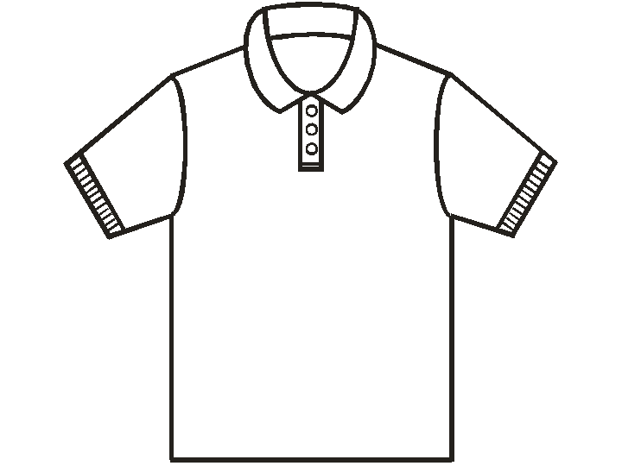
Suggested Personnel
Athletes (lots)
Barrier (i.e. table / fence)
(Small opening)
Barrier (i.e. table / fence)
Gate
Keeper
(Pool)
Clerk & Assistant table
Greeter
Assistant
Clerk
Runner
Bench (fits up to 8)
Barrier (fence)
Bench (fits up to 8)
Runner
Bench 1
Bench (fits up to 8)
Bench (fits up to 8)
Bench (fits up to 8)
Bench 2
Bench (fits up to 8)
Bench (fits up to 8)
Athlete Entrance
Pool
Marshall

Slide 11
Calling of Athletes & Alternates
Athletes/alternates are responsible for reporting to the Clerk of the Course in time for their race.
Each athlete must be close enough to the Clerk to hear announcements and to make their presence known to the Clerk
For finals - Clerk shall announce the event at least twice, with at least two minutes between each announcement
Times of the calls should be noted on the Clerk’s Heat Sheet
Notes:
Athletes and alternates are responsible for reporting to the Clerk of the Course in time for their race.
The Clerk shall announce the event at least twice, with at least two minutes between each announcement - these times should be noted on the Clerk’s Heat Sheet
It is the responsibility of each Athlete to be close enough to the Clerk to hear these announcements and to make their presence known to the Clerk.

Slide 12
Calling of Athletes & Alternates
Clerk shall not make “personal calls.”
If Clerk has completed the required calls and an athlete has not checked in, the Clerk shall call the alternate (allowing the alternate one minute to report)
Once an alternate has been called, the listed qualifiers and any previously called alternate are irrevocably scratched from the event
Notes:
The Clerk shall not make “personal calls.”
If the Clerk has completed the required calls and an athlete has not checked in, the Clerk shall call the alternate allowing one minute for them to report
Once an alternate has been called, the listed qualifiers and any previously called alternate are irrevocably scratched from the event

Slide 13
Simplified Marshalling Procedure (SMP)
At the discretion of the Meet Manager, a Simplified Marshalling Procedure (SMP) may be used for some or all Preliminary and/or Finals sessions of a BCSSA hosted meet.
If SMP is to be used, the Meet Manager shall inform all participating clubs prior to the meet start in the Meet Package
Under SMP there will be NO check-in, marshalling, or announcing of events
SMP is typically used for Divisions 5 and older
Notes:
Jamboree style events, where all different divisions compete off their entry times, may receive special marshalling instructions from the Meet Manager

Slide 14
Simplified Marshalling Procedure (SMP)
Meet Manager may provide a ‘green room’ area for the athletes to congregate prior to their race (space permitting)
Meet Manager shall post current heat sheets in a conspicuous location
In the event that an athlete is NOT behind the blocks when the Session Referee calls their race, then the Session Referee may call the designated alternate, if any, to swim in their place
Alternate shall identify themselves to the Session Referee, and shall report immediately to the correct lane as directed by the Session Referee
Notes:
As space permits, the Meet Manager may provide a ‘green room’ area for the athletes to congregate prior to their race.
The Meet Manager shall post current heat sheets in a conspicuous location to allow athletes to verify their event, heat and lane assignments
In the event that an athlete is NOT behind the blocks when the Session Referee calls their race, then the Session Referee may call the designated alternate, if any, to swim in their place. In this case the original athlete shall be deemed a ‘late scratch’
The alternate shall identify themselves to the Session Referee, and shall report immediately to the correct lane as directed by the Session Referee.

Slide 15
Flow of Calling Athletes
Athletes (lots)
Barrier (i.e. table / fence)
(Small opening)
Barrier (i.e. table / fence)
Marshall
(Pool)
Clerk & Assistant table
Greeter
Assistant
Clerk
Runner
Bench (fits 8)
Barrier (fence)
Bench (fits 8)
Runner
Bench 1
Bench (fits 8)
Bench (fits 8)
Bench (fits 8)
Bench 2
Bench (fits 8)
Bench (fits 8)
Athlete Entrance
Overview
Barrier (fence)
Notes:
Note to possibly add diagram of the pool

Slide 16
Flow of Calling Athletes
Example (Prelim Heats)
Barrier (i.e. table / fence)
Barrier (i.e. table / fence)
(Small opening)
Div 1 girls approach the clerk and provide their names
Gate Keeper gets all boys to move to the side to allow the girls heats to be marshalled
(Pool)
Gate
Keeper
Clerk & Assistant table
Clerk calls for all heats Event 101, Girls Div1 IM
Greeter
Assistant
Clerk
Greeter confirms athlete name and directs them to Bench Marshalls
Runner
Bench (fits 8)
Pool
Marshall
Heat 1
Barrier (fence)
Bench (fits 8)
Runner
Bench Marshalls help direct athletes to benches in correct heat and lane
Bench 1
Bench (fits 8)
Heat 3
Bench (fits 8)
Bench (fits 8)
Shift Up
Heat 3
Bench (fits 8)
Bench 2
Heat 2
Shift Up
Heat 2
Heat 1
Bench (fits 8)
Completed Marshalling for Div 1 Girls 100IM
Enters with Pool Marshall
Athlete Entrance
Pool
Marshall
Barrier (fence)
Notes:
Note to possibly add diagram of the pool

Slide 17
Flow of Calling Athletes
Example (Finals)
10
8
5
3
1
9
7
2
4
Barrier (i.e. table / fence)
Barrier (i.e. table / fence)
(Small opening)
Marshall requests boys stand aside and let girls through
9
10
(Pool)
Gate
Keeper
(Alternates spot for waiting)
Clerk & Assistant table
Clerk Announces Event being Marshalled and to please come forward and provide name, and notes time of first call on heat sheet
If at least 2 minutes have passed since first call - Clerk announces 2nd Call for Event being Marshalled and to please come forward and provide name, and notes time of call on heat sheet
Greeter
If athlete in lane 7 does not come forward within a minute, then call made for alternates… The 9th placed athlete is waiting in the Alternates area and steps forward, so would be placed in lane 7. As all spots in the final are filled, the 10th placed athlete may be politely asked to leave the marshalling area
Assistant
Clerk
Runner
Clerk fills out 3 alternate forms that 6th place athlete (lane 7) is being replaced by 1st alternate.
Runners will take slips to lane 7 timers, Session Ref and Office
Bench (fits 8)
Barrier (fence)
Bench (fits 8)
Runner
Bench 1
Bench (fits 8)
(Marshalling Occurs…)
Bench (fits 8)
Bench (fits 8)
Bench 2
Bench (fits 8)
4
Bench (fits 8)
7
5
3
1
2
9
8
Athlete Entrance
Pool
Marshall
Note Lane 7 is missing…
Barrier (fence)
Notes:
Note that the numbers on the circles represent the placing of the athlete, NOT the lane they are in…

Slide 18
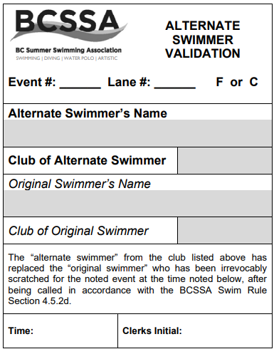
Alternate Form Example
Available on the BCSSA Web site
3 cards to be filled out: Session Ref, Office and Lane Recorder
101
7
Sally Jones
COQ
Daisy Xu
RIC
8:02
JR

Slide 19
Marshalling Relays
Relays = 4 times the number of athletes than individual events (also additional crowds near the marshalling entrance!)
Relay cards should be dropped off to the Clerk of the Course by the Chief Meet Recorder prior to the event
When athletes are called to Marshalling, it is still done by event

Slide 20
Marshalling Relays
4 athletes per team (may include alternates)
Never show relay cards to athletes - ask names and check them off
Upon confirming names (4) on relay card, Clerk initials card and returns it to the team
Relay team is instructed to give card to the lane recorder for their lane
Remind athletes to not lose the card or they may not be able to race!
Notes:
There should only be 4 athletes per team, and the team may be made up of alternates as well
When speaking to the Clerk of the Course, the relay card should not be shown to any athletes. Instead the Clerk should ask the names of the relay team members, checking them off as they are given
Upon confirming 4 valid names on the relay card, with the names checked off the Clerk would initial the relay card and provide the card to 1 of the relay team members and instruct them to give this card to the lane recorder for the lane they are in and to politely remind them to not lose the card or they may be unable to race

Slide 21
Quiz

Slide 22
Thank-You for Attending
If you have any questions please ask the course conductor.
Please ensure you have signed the attendance sheet to record your participation in the clinic.
Approved by the BCSSA Rules & Regulations Committee

